Slide 1









My Number Interactive Notebook
$$×$$
$$\frac{1}{2}$$
$$÷$$
$$+$$
$$−$$
$$\frac{3}{5}$$
$$7$$
Name
Class
Teacher
Term 1 Semester 1
$$5^{2}$$
$$\sqrt{9}$$
1

Slide 2
Contents
Glossary or Formula Page
Page
Date
Description
2
3

Slide 3
Tasks
24
7
30
Essential Question
Questions
Notes
Summary
4
5

Slide 4
24
7
30
Date
Index Notation
EQ – How do I expand a number written in index form?
5

Slide 5

24
7
30
Date
Index Notation
EQ – How do I expand a number written in index form?
Index
Base
What is index notation?
$$3^{5}=3×3×3×3×3$$
5

Slide 6

24
7
30
Date
Index Notation
EQ – How do I expand a number written in index form?
What is index notation?
Index or exponent
Base
$$3^{5} =3×3×3×3×3$$
Power Form
or index form
5

Slide 7
24
7
30
Date
Index Notation
EQ – How do I expand a number written in index form?
What is index notation?
Index or exponent
Base
$$3^{5} =3×3×3×3×3$$
Power Form
or index form
Extended or expanded form
5

Slide 8
24
7
30
Date
Index Notation
EQ – How do I calculate the value of a number to the power of a positive or negative integer?
What is index notation?
Index or exponent
Base
$$3^{5} =3×3×3×3×3$$
Power Form
or index form
Extended or expanded form
The index shows the number of times the base is multiplied by itself
5

Slide 9
24
7
30
Date
Index Notation
EQ – How do I calculate the value of a number to the power of a positive or negative integer?
What is index notation?
Index or exponent
Base
$$3^{5} =3×3×3×3×3$$
Power Form
or index form
Extended or expanded form
The index shows the number of times the base is multiplied by itself
How to you evaluate a base to the power of one or zero?
5

Slide 10

Task – Write in expanded form and find the value
$2^{5}$=
$2^{4}$=
$2^{3}$=
$2^{2}$=
Look at the pattern- Can you find the value of
$2^{1}=$
$2^{0}=$

Slide 11


24
7
30
Date
Index Notation
EQ – How do I calculate the value of a number to the power of a positive or negative integer?
What is index notation?
Index or exponent
Base
$$3^{5} =3×3×3×3×3$$
Power Form
or index form
Extended or expanded form
The index shows the number of times the base is multiplied by itself
How to you evaluate a base to the power of one or zero?
$$a^{1}=a e.g. { 12}^{1}=12$$
$$a^{0}=1 e.g. { 15}^{0}=1$$
5

Slide 12
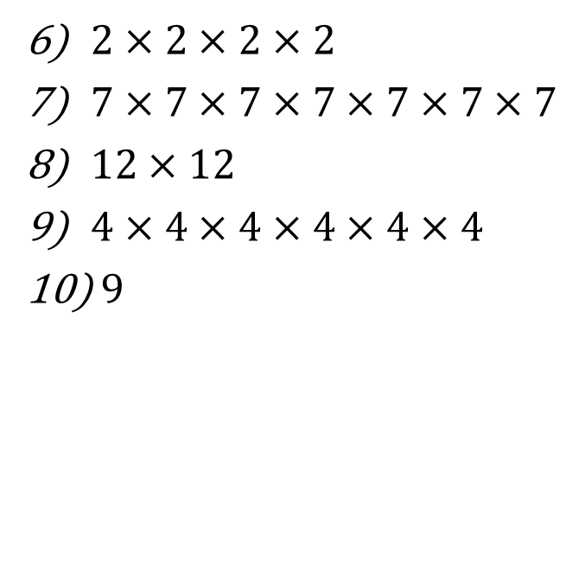


Task
Write in expanded form
Write in index form
$6^{2}=$
$2^{4}=$
$8^{5}=$
${15}^{3}=$
$2^{1}=$
$2×2×2×2$
$7×7×7×7×7×7×7$
$12×12$
$4×4×4×4×4×4$
$9$
Find the value of
${ 5}^{2}$
${ 10}^{3}$
${ 18}^{1}$
${ 9}^{0}$
${ 2}^{1}×8^{0}$

Slide 13
Notes Review
24, 7 ,30
Date
Title
Essential question
Notes complete
Notes complete with colour and diagrams
Questions completed
Contents page filed in
Formula page filled in

Slide 14
Homework
Review your notes and write a summary answering the essential question.

